Slide 1
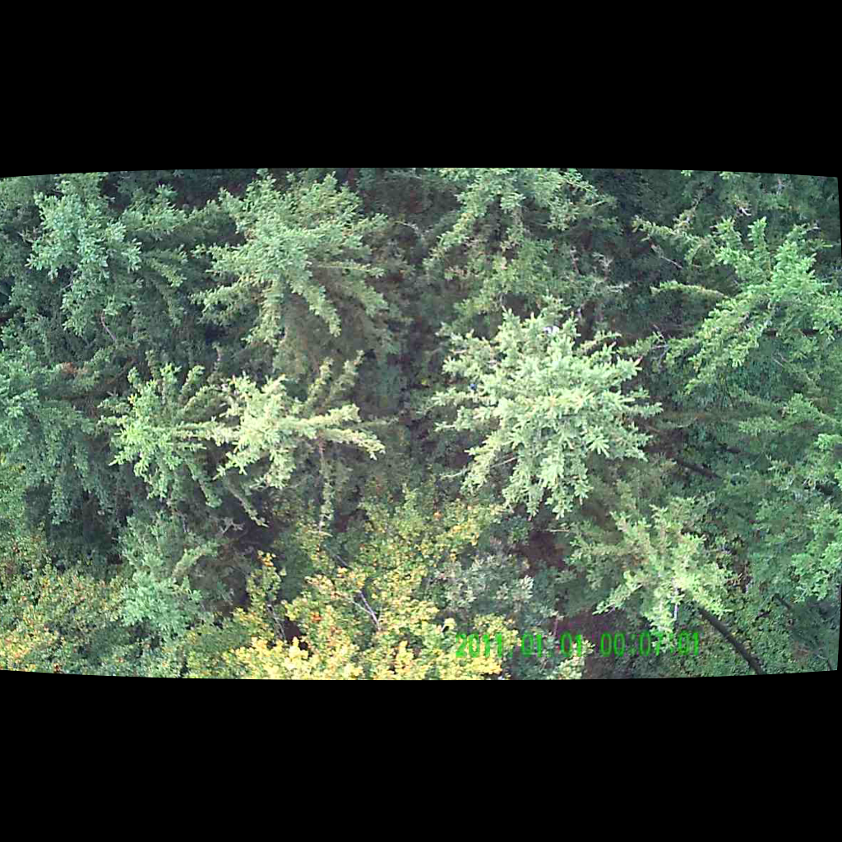
UNSUPERVISED PERSON LOCALIZATION IN WISAR Intermediate Results
Team C9
Nikolas Boldis Daniel Deutsch Lisa Schneckenreiter Uta Wagner
UE Computer Vision
12th January, 2022

Slide 2
2 Main Directions
Person detection by simple image transformations
Variance domain between timepoints
Subtraction different colour channels
Further work on autoencoder
Fixing dataloaders
Displaying reconstructed images
Plotting Activations
UE Computer Vision, 12th January, 2021

Slide 3
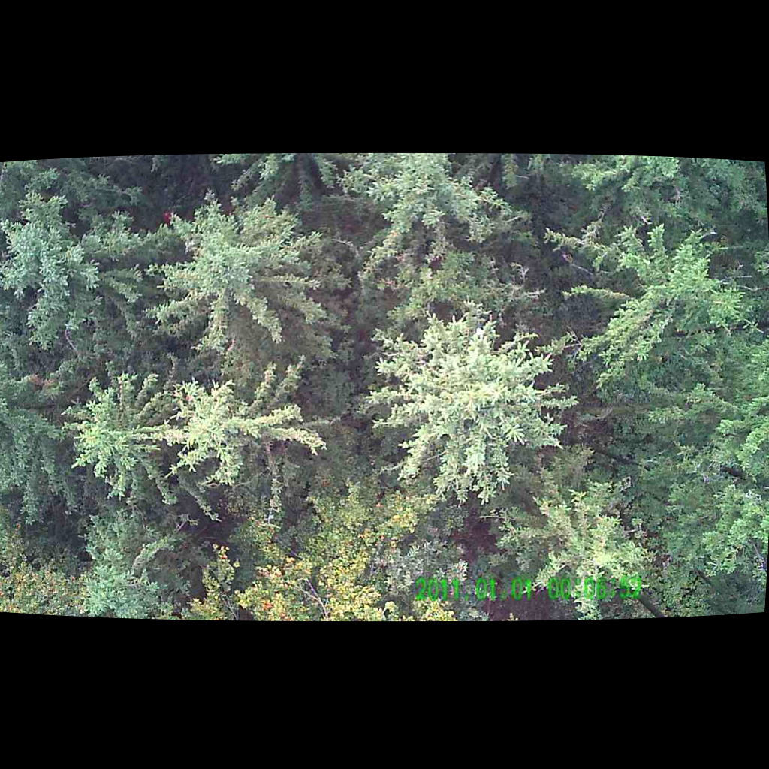
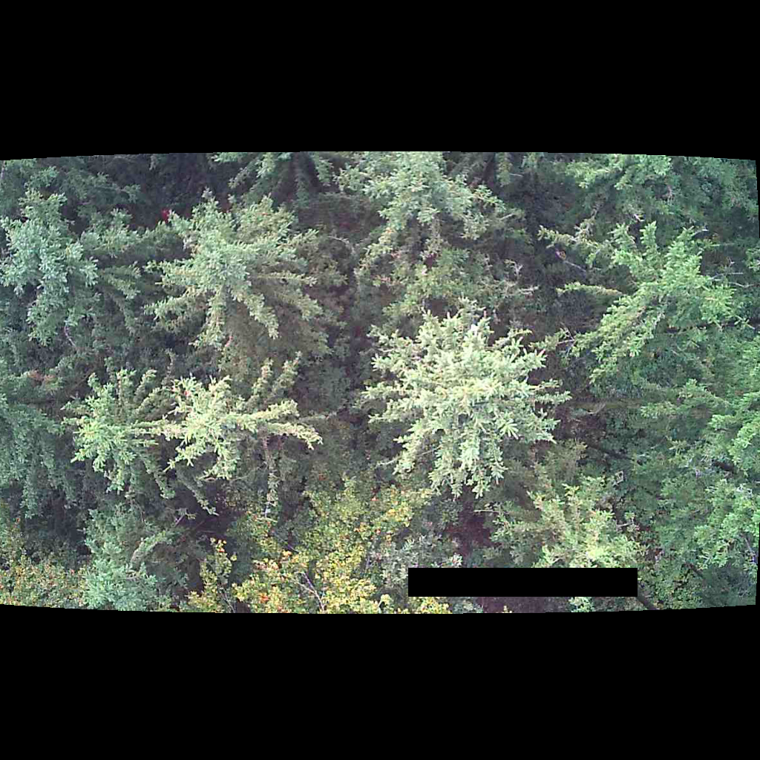

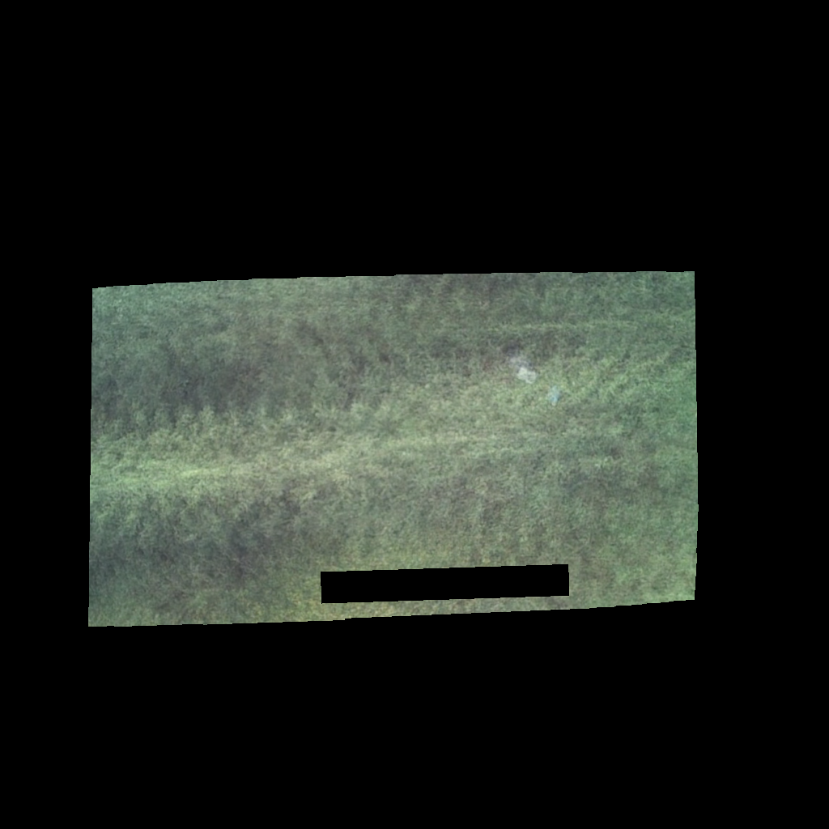
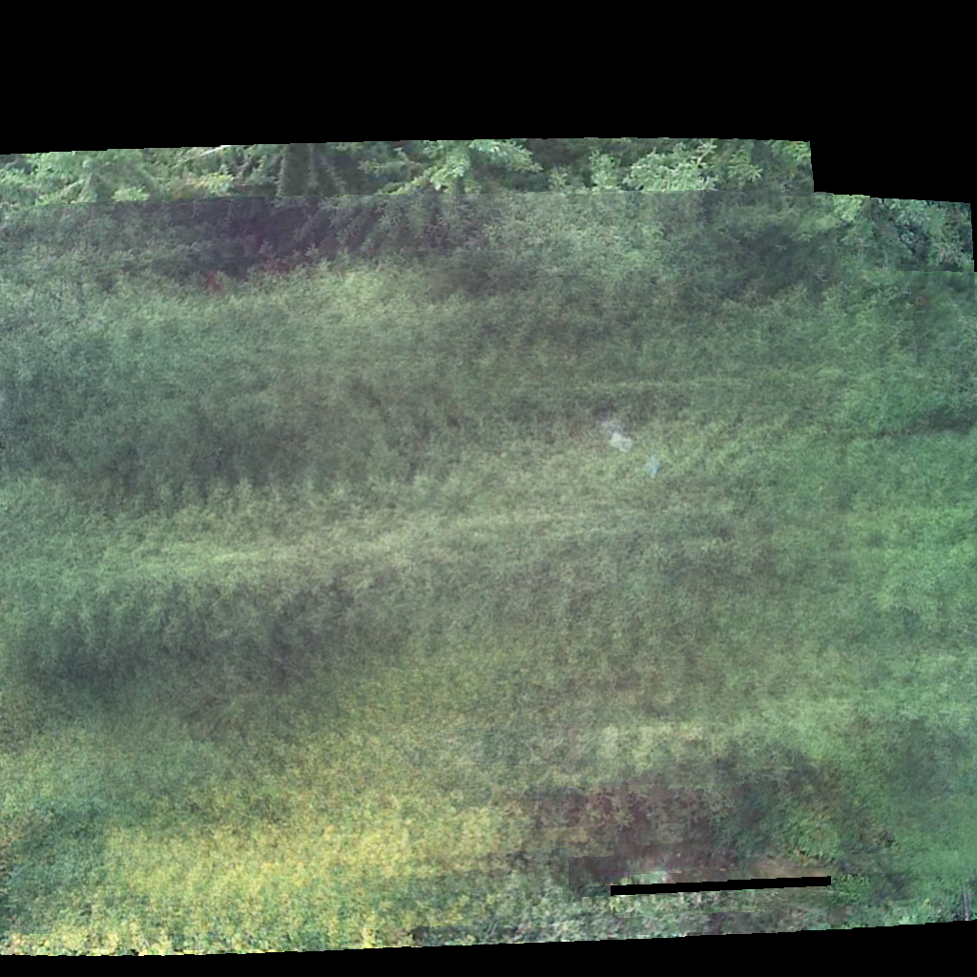
Image pre-processing
1. apply mask for time stamp
2. warp to the same perspective
3. average over parallel recorded images
4. remove areas not covered by all 10 images
UE Computer Vision, 12th January, 2021

Slide 4
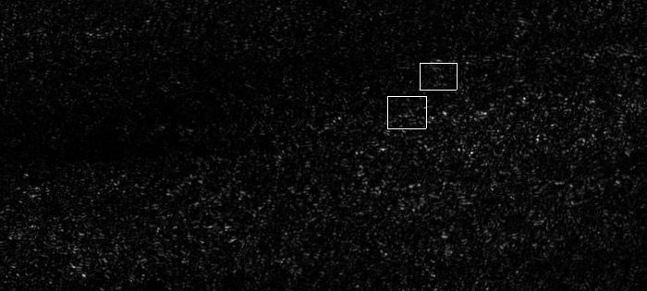
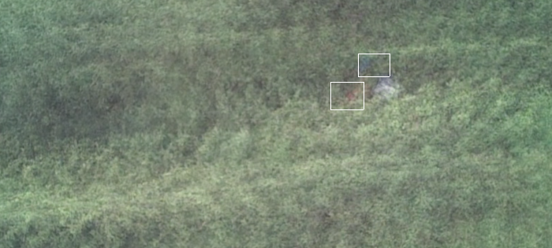
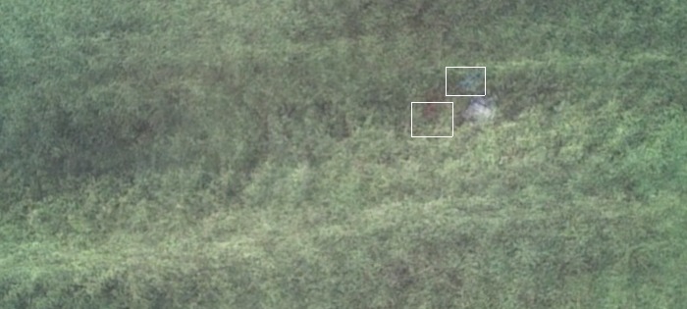
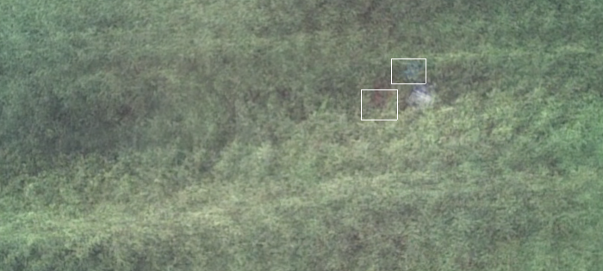
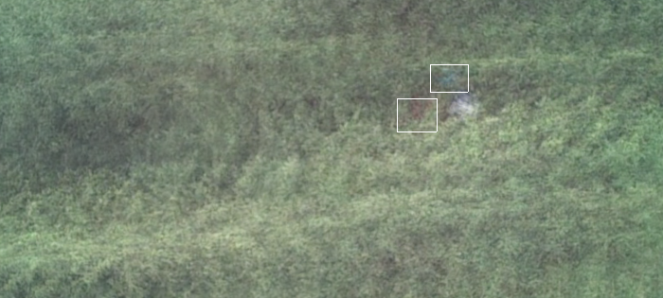
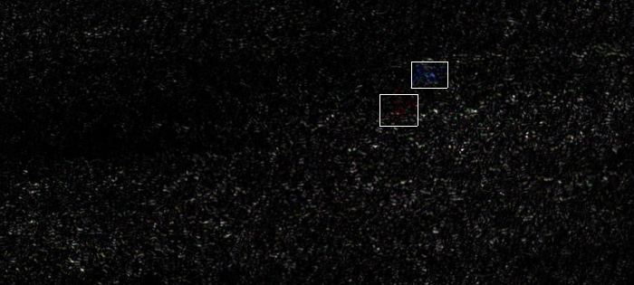
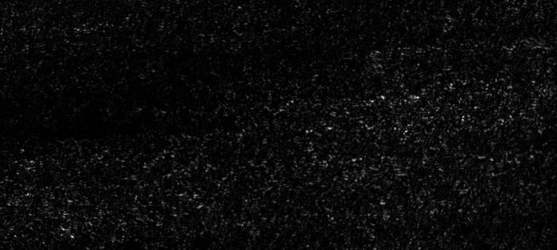


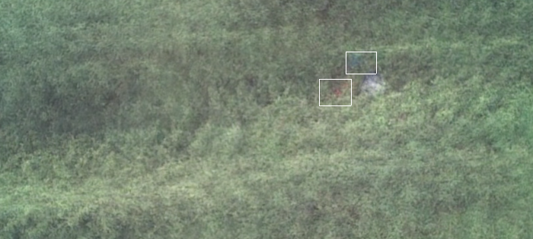
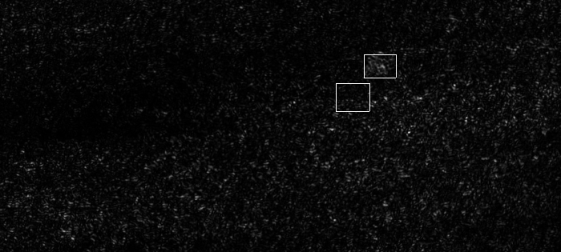
Further image processing
7x700x315 px
R
Variance
G
B
UE Computer Vision, 12th January, 2021

Slide 5
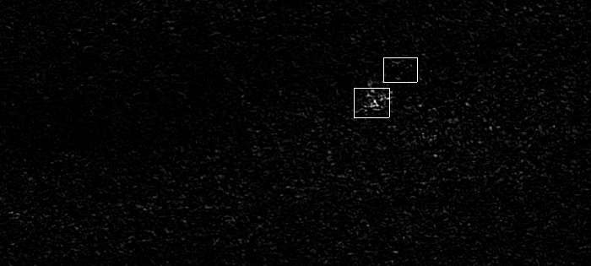
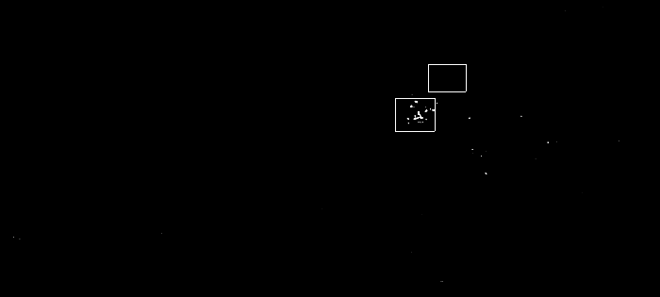
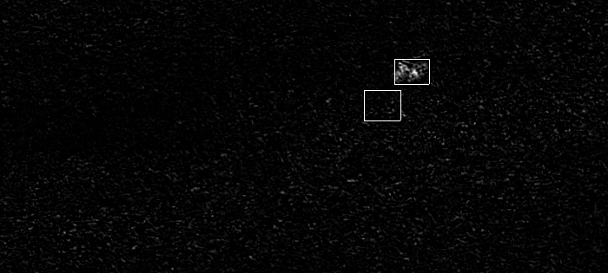
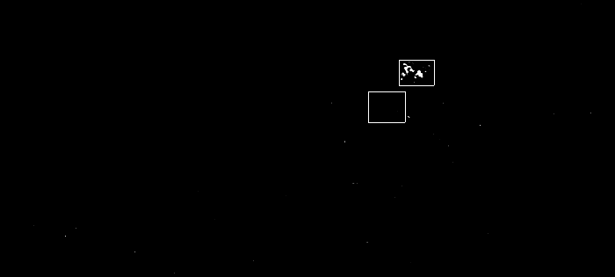
Further image processing
Contrast ↑
Brightness↓
R - G
R
G
B
B - G
UE Computer Vision, 12th January, 2021

Slide 6
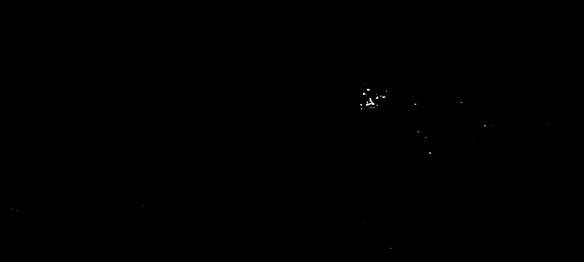
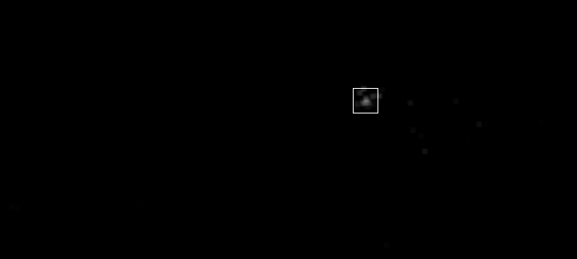
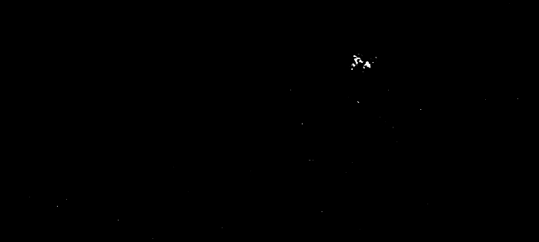

Person detection
7x7 Gaussian blur
Center rectangle around brightest pixel
R - G
B - G
Targets
[594, 438, 40, 29]
[559, 474, 42, 35]
IoU
0.73
0.61
Detections
[602, 438, 30, 30]
[568, 477, 30, 30]
UE Computer Vision, 12th January, 2021

Slide 7
Person detection by simple image transformations
Advantage:
can distinguish people from other objects by detecting movement
Disadvantages:
fixed size of labels → to be improved
bias towards detecting people wearing blue or red – problems finding people with green clothing
cannot detect people that are not moving or moving too little
UE Computer Vision, 12th January, 2021

Slide 8
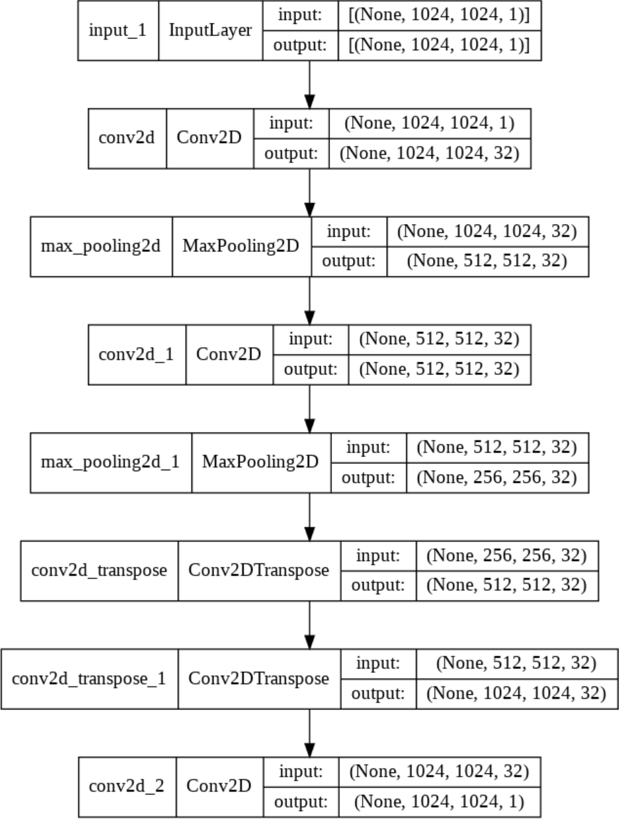
Autoencoder - Architecture
Base is Convolutional autoencoder for image denoising from official keras docs
Adapted loss for Structural Similarity Index (SSIM)
Decided for that because
Relatively straight forward to tune
Simple architecture
Sufficient for our image detection problem
UE Computer Vision, 12th January, 2021

Slide 9
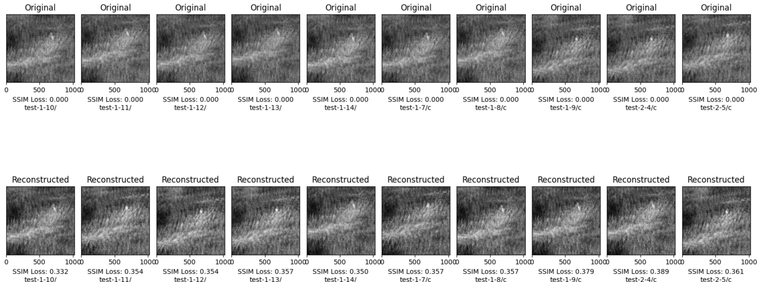
Challenges
Find perfect length of training to not overfit the data
Overfitting leads to perfect reconstructions that learn to balance anomalies
Underfitting leads to too many differences in the very occluded ground truth
UE Computer Vision, 12th January, 2021

Slide 10
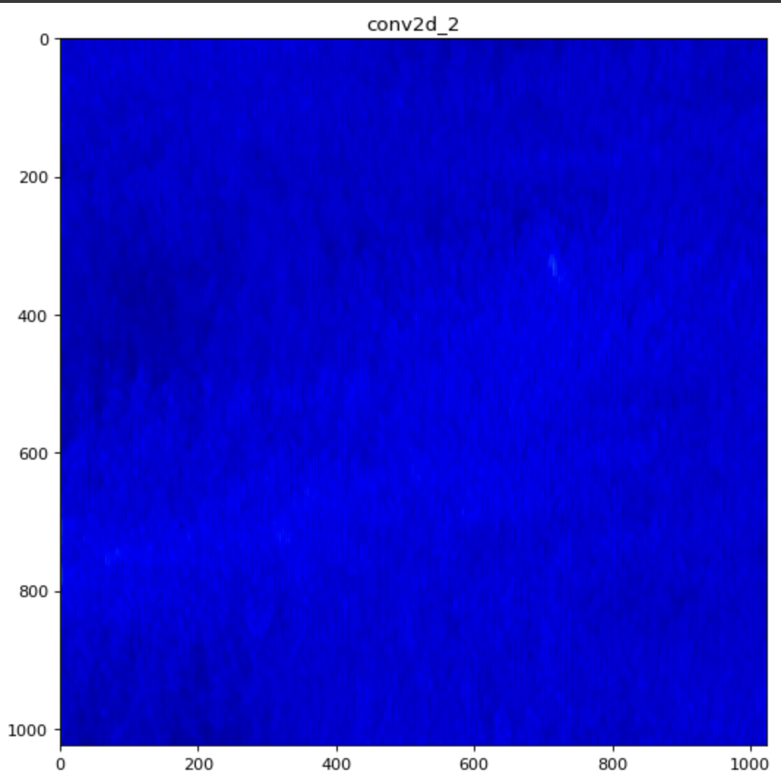
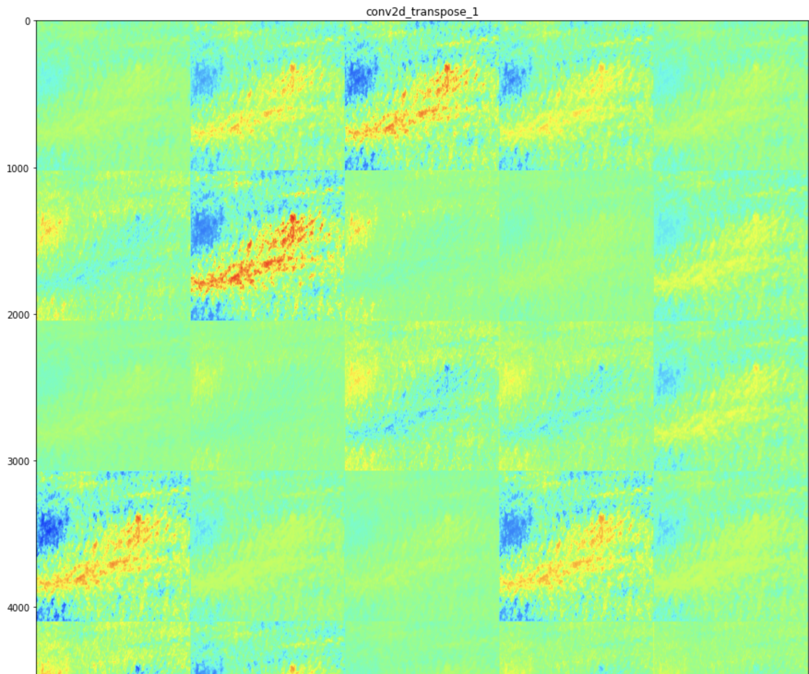
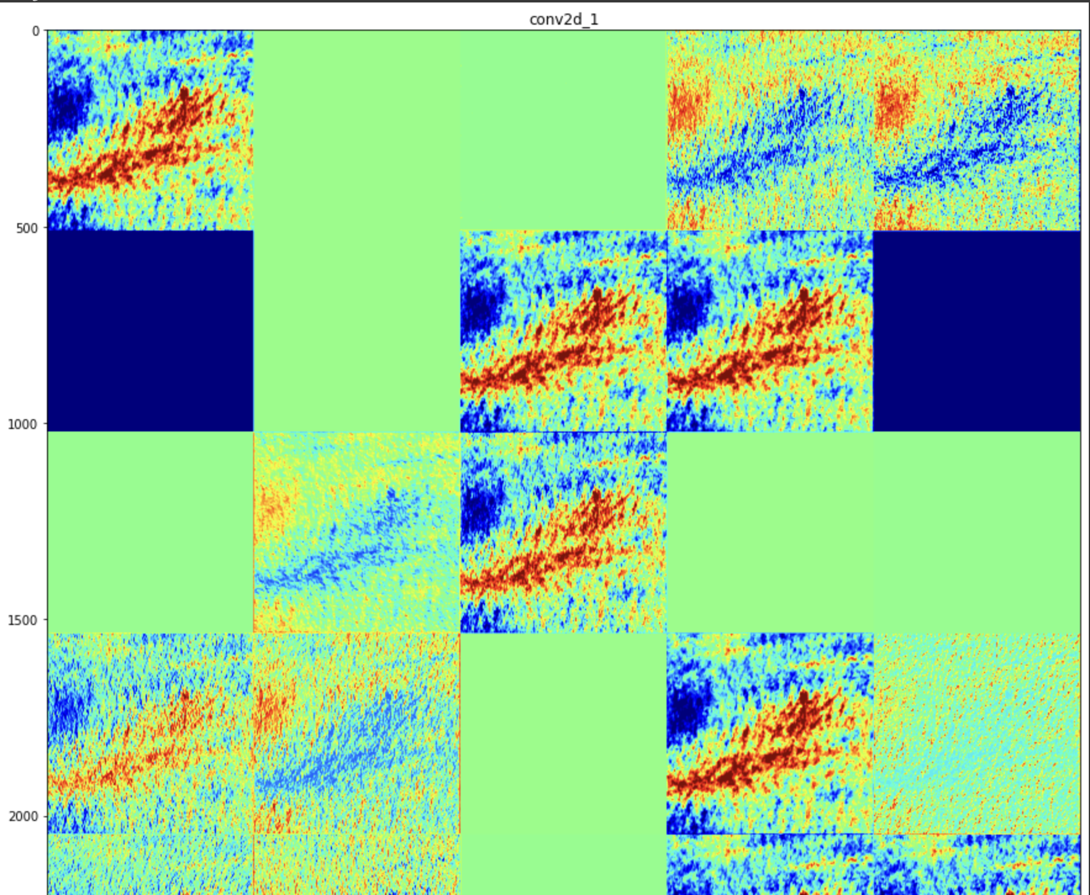
Challenges
Visualizing Activations
UE Computer Vision, 12th January, 2021

Slide 11
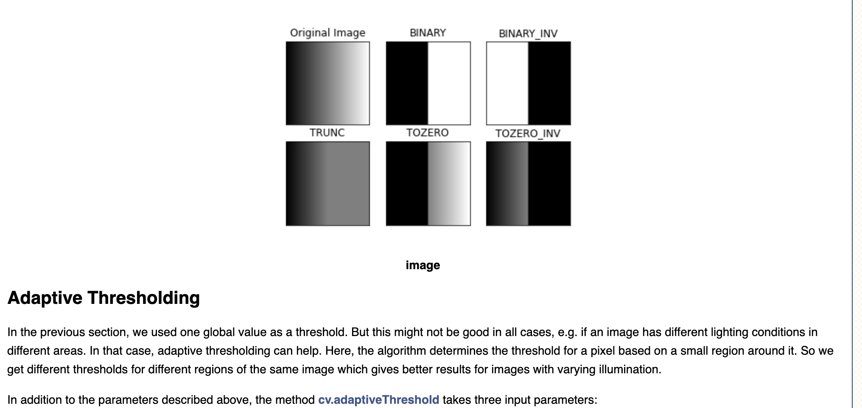
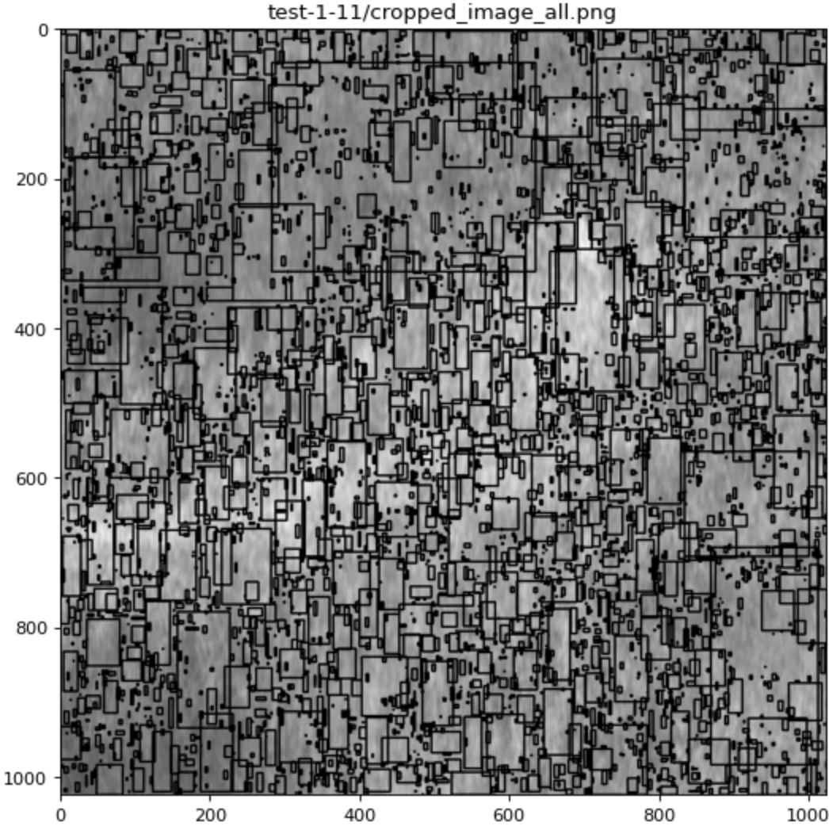
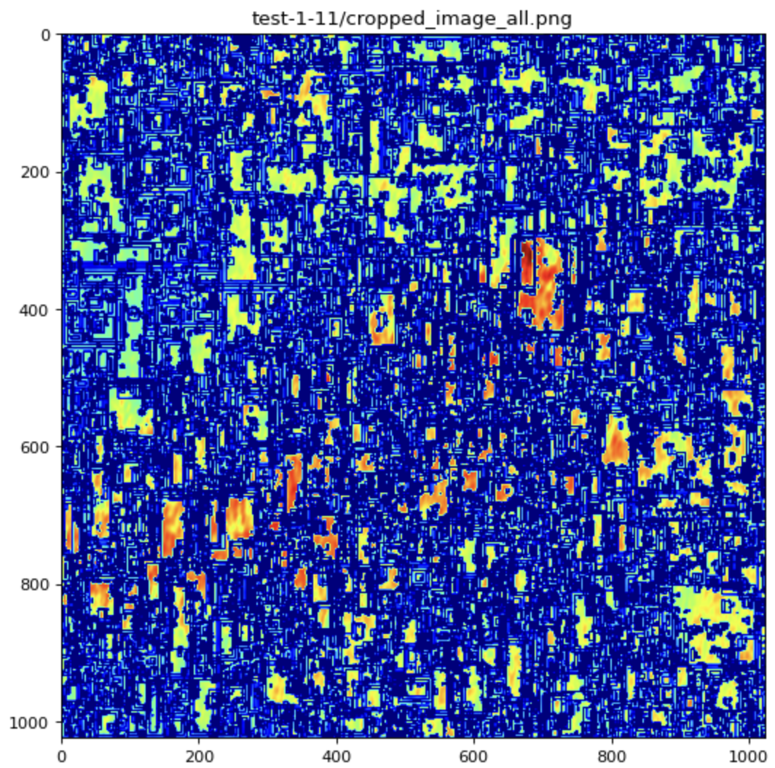
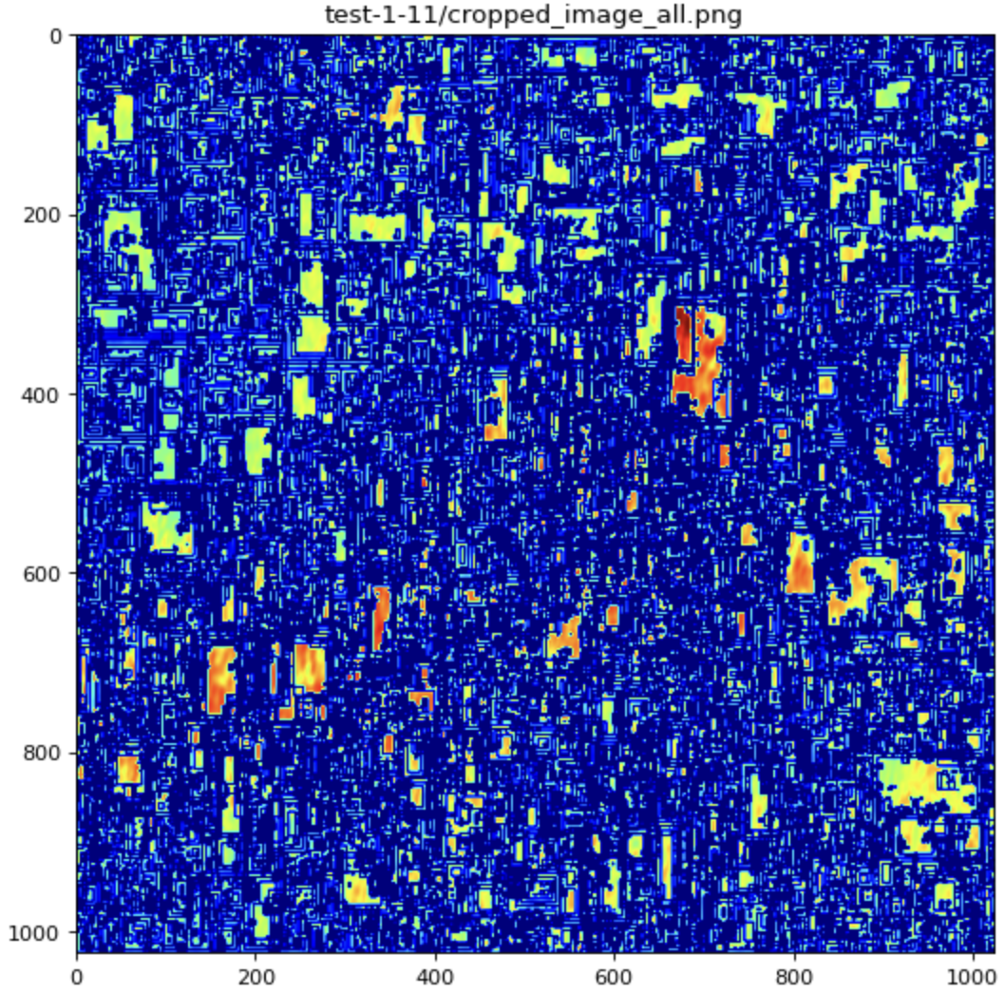
Challenges
Adapting threshold for finding what amount of difference is enought to declare an anomaly
OpenCV Thresholds:
UE Computer Vision, 12th January, 2021

Slide 12
Next steps
Build autoencoder with colored images
Feed autoencoder the enhanced pre-processed images and see differences
Build function to draw rectangles for evaluation script
Fine tune
UE Computer Vision, 12th January, 2021

Slide 13
THANK YOU FOR YOUR ATTENTION!

